Slide 1

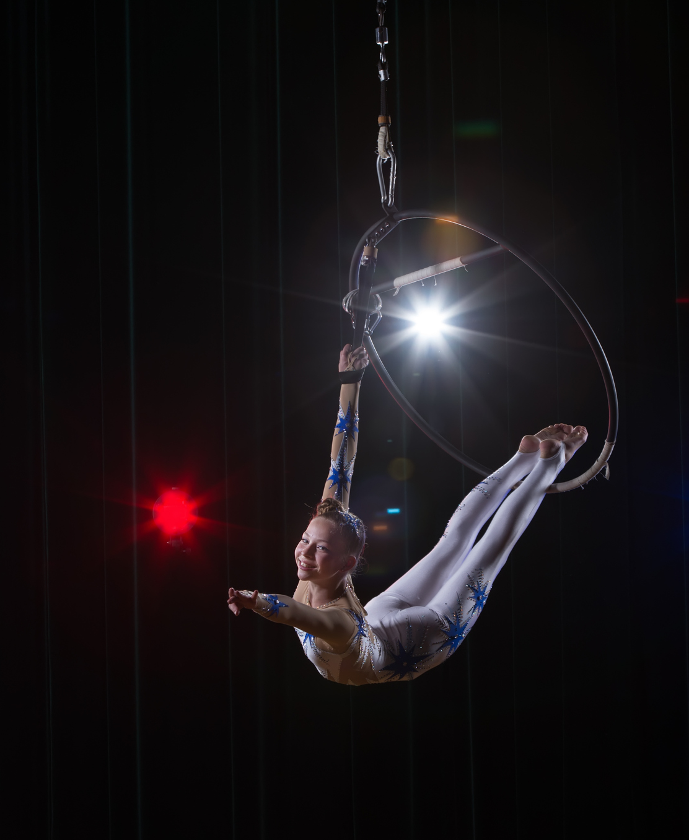

Arts During Lockdown
National Survey June 2020
Prepared by
John O’Mahony
J.201993/JOM

Slide 2

Research Background &
Objectives

Slide 3

Research Background & Objectives
This National Survey was conducted to establish levels of willingness to attend live arts events and alternative formats as Ireland adapts to the Covid 19 pandemic.
The full programme of interviews was conducted online and all aspects of the online survey design were managed by Behaviour & Attitudes internally with the sample drawn from our own consumer panel Acumen.​
B&A’s Online Omnibus is strictly quota controlled to reflect the national population and delivers a sample of 1,000 adults aged 16 years plus.​
The sample selected for the survey is extracted abiding by strict contact rules with individuals randomly selected within the survey target groupings. The quality controls applied to each survey include a series of integrity checks, including time for completion and screening data response patterns.​
Comparisons with previous Arts Council national surveys are drawn where possible (with the caveat previous research used face to face approach for data collection).
This research was conducted in June 2020.

Slide 4





Sample Profile : Demographics
Base: All Adults aged 16+ n – 999
 |  | % |  |  |  | %
Gender | Male | 49 |  | Region | Dublin | 29
 | Female | 51 |  |  | Leinster | 27
Age | 18-24 | 14 |  |  | Munster | 27
 | 25-34 | 16 |  |  | Conn/Ulster | 18
 | 35-49 | 31 |  | Area | Urban | 66
 | 50-64 | 20 |  |  | Rural | 34
 | 65+ | 18
Social Class | ABC1F | 49
 | C2DE | 51
Male
Female
49%
51%
Dublin
29%
Urban
66%
Rural
34%
Analysis of Sample

Slide 5

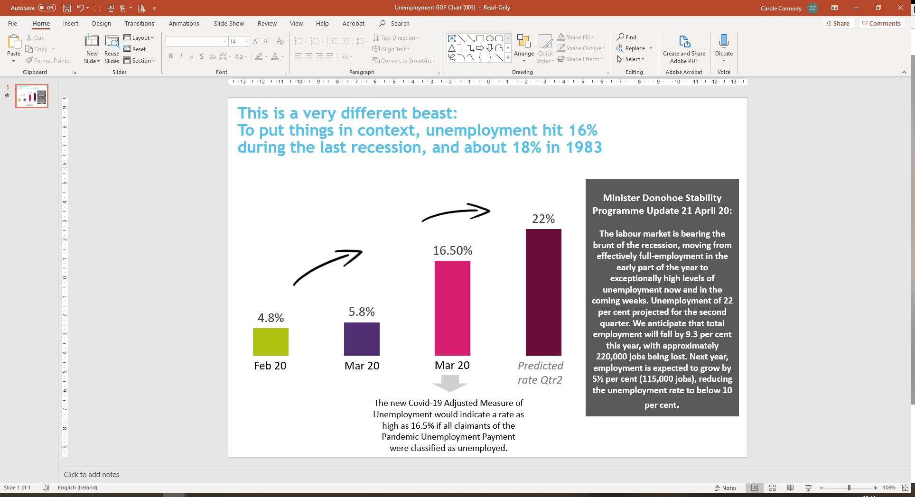
Covid-19: Life has changed dramatically…
although at the time of this fieldwork (June 2020) it was beginning to feel that the worst of the virus may be over
Now that the number of cases is declining, economic issues are beginning to come to the fore..
29th Feb: First confirmed case of Covid-19 diagnosed in Ireland
15th March: 292 cases, 2 deaths, schools, universities, childcare settings, pubs, playgrounds, stores closed. Social distancing measures in place. Stock markets plunging. Gatherings/Celebrations/ festivities cancelled.
5th May 21,983 cases, 1,339 deaths. Lockdown measures extended to 18th May, will continue in some form until the end of the summer at least.
5th June 25,163 cases, 1,670 deaths. Announcement made that lockdown measures were to be eased, and the plan was to be accelerated.

Slide 6

Arts attendance ‘past 12 months’ Pre - Lockdown

Slide 7
Arts attendance ‘past 12 months’ Pre - Lockdown
Base: Adults aged 16+ n – 999
2018/19 Average
%
53
20
19
20
17
13
17
8
16
10
7
14
5
7
6
5
4
7
7
2
4
6
79
‘Past 12 Months’ Pre – Lockdown’
 | %
The ‘past 12 months’ arts attendance pattern in June 2020 is largely in line with the results from previous research; 81% of Irish adults indicate they attended any arts event in that pre- Lockdown period (average 79% 2018/2019).
Q.1 Thinking back now to the 12 months prior to the start of the Covid 19 crisis in Ireland in March 2020; in those 12 months, from March 2019 to March 2020, did you attend any of the following events outside the home?

Slide 8
Arts attendance ‘past 12 months’ Pre - Lockdown: Segmentation
Base : All Adults aged 16+ n- 999
‘Past 12 Months’
Pre – Lockdown %
2018/19
Average
%
1-2 Types
“Occassionals”
3-4 Types
“Regulars”
5 + Types
“Aficionados”
“Films only”
“None”
69% of all Irish adults are ‘arts goers’ (excl. ‘films only’/ ‘none’).
Aficionados again account for c. 1 in 5 arts attendees (and from previous research c. 50% of all attendances).
Q.1 Thinking back now to the 12 months prior to the start of the Covid 19 crisis in Ireland in March 2020; in those 12 months, from March 2019 to March 2020, did you attend any of the following events outside the home?

Slide 9
Arts attendance ‘past 12 months’ Pre - Lockdown: Segmentation Profile
Base: All Adults aged 16+ n – 999
 | TOTAL | ARTS SEGMENTATION
 |  | Any Arts Goers | Occasionals | Regulars | Aficionados | Films (only) | None
UNWTD | 999 | 693 | 237 | 256 | 200 | 115 | 191
 | % | % | % | % | % | % | %
Gender
Male | 49 | 49 | 47 | 51 | 46 | 55 | 47
Female | 51 | 51 | 53 | 49 | 54 | 45 | 53
Age
16-24 | 14 | 16 | 13 | 14 | 22 | 19 | 6
25-34 | 16 | 18 | 19 | 20 | 14 | 17 | 9
34-49 | 31 | 31 | 33 | 30 | 30 | 34 | 29
50-64 | 20 | 19 | 18 | 21 | 19 | 18 | 26
65+ | 18 | 16 | 17 | 15 | 15 | 12 | 30
Social Class
ABC1F50+ | 49 | 54 | 48 | 56 | 60 | 43 | 31
C2DEF50- | 51 | 46 | 52 | 44 | 40 | 57 | 69
Region
Dublin | 29 | 30 | 28 | 31 | 31 | 34 | 22
EX-Dublin | 71 | 70 | 72 | 69 | 69 | 66 | 78
Rest Of Leinster | 27 | 24 | 26 | 22 | 25 | 31 | 33
Munster | 27 | 28 | 28 | 30 | 25 | 17 | 28
Connaught/Ulster | 18 | 18 | 19 | 16 | 19 | 18 | 17
Area
Urban | 66 | 67 | 65 | 67 | 71 | 63 | 62
Rural | 34 | 33 | 35 | 33 | 29 | 37 | 38
In demographic terms, ‘Aficionados’ are primarily distinctive in relation to social grade – being much more likely to be ABC1
Q.1 Thinking back now to the 12 months prior to the start of the Covid 19 crisis in Ireland in March 2020; in those 12 months, from March 2019 to March 2020, did you attend any of the following events outside the home?

Slide 10

The Arts & Living with Covid

Slide 11
Level of concern with attending arts events/ venues (June 2020)
Base: Adults aged 16+ n – 999
Music or other performance in a standing indoor venue | Concert Hall/ Opera House (indoors) | Theatre, Music, Dance or talk in a seated indoor venue | Multiplex Cinema | Art Gallery (indoors) | Music or other performance at an outdoor venue | Street arts (e.g. outdoor based performance/ parade/ carnival/ circus)
% | % | % | % | % | % | %
Very concerned
Somewhat concerned
Not very concerned
Not at all concerned
Any concerned | 78 | 76 | 75 | 74 | 65 | 61 | 56
As of June 2020, there is widespread concern at attending live arts events – the key distinction however is between indoor and outdoor venues. Attendees, especially the earliest returners, will clearly need extensive reassurances.
Q.2 How concerned are you about attending an arts event in the following venues ...

Slide 12
Level of concern with attending arts events/venues: Very concerned x Arts segmentation
Base: Adults aged 16+ n – 999
Very Concerned | TOTAL | ARTS SEGMENTATION
 |  | Any Arts Goers | Occasionals | Regulars | Aficionados | Films (only) | None
UNWTD | 999 | 693 | 237 | 256 | 200 | 115 | 191
 | % | % | % | % | % | % | %
Music or other performance in a standing indoor venue | 40 | 40 | 40 | 36 | 47 | 33 | 41
Concert Hall/Opera House (indoors) | 33 | 33 | 32 | 29 | 38 | 30 | 35
Multiplex Cinema | 32 | 30 | 31 | 29 | 32 | 33 | 40
Theatre, Music, Dance or talk in a seated indoor venue | 32 | 32 | 31 | 30 | 37 | 29 | 35
Art Gallery (indoors) | 23 | 22 | 24 | 20 | 21 | 24 | 25
Music or other performance at an outdoor venue | 21 | 19 | 23 | 17 | 16 | 23 | 27
Street arts (e.g. outdoor based performance/ parade/ carnival/ circus) | 17 | 15 | 20 | 10 | 15 | 23 | 23
Levels of high concern with indoor arts venues consistently peak among Aficionados (i.e. those most familiar with these venues).
Q.2 How concerned are you about attending an arts event in the following venues ...

Slide 13
Level of concern with attending arts events/venues: Very concerned x demographics
Base: Adults aged 16+ n – 999
Very Concerned | TOTAL | Gender |  | Age |  |  |  |  | Social Class |  | Region |  | Area
 |  | Male | Female | -24 | 25-34 | 35-49 | 50-64 | 65+ | ABC1F | C2DE | Dublin | Outside Dublin | Urban | Rural
UNWTD | 999 | 479 | 520 | 133 | 177 | 318 | 238 | 133 | 515 | 484 | 283 | 716 | 720 | 279
 | % | % | % | % | % | % | % | % | % | % | % | % | % | %
Music or other performance in a standing indoor venue | 40 | 33 | 46 | 33 | 36 | 39 | 42 | 46 | 39 | 40 | 44 | 38 | 41 | 38
Concert Hall/Opera House (indoors) | 33 | 25 | 40 | 28 | 34 | 32 | 38 | 31 | 33 | 33 | 37 | 31 | 34 | 31
Multiplex Cinema | 32 | 28 | 37 | 24 | 30 | 30 | 40 | 37 | 32 | 32 | 34 | 32 | 33 | 32
Theatre, Music, Dance or talk in a seated indoor venue | 32 | 27 | 38 | 24 | 35 | 30 | 34 | 38 | 32 | 33 | 35 | 31 | 33 | 31
Art Gallery (indoors) | 23 | 20 | 26 | 19 | 27 | 21 | 25 | 22 | 20 | 25 | 26 | 22 | 23 | 22
Music or other performance at an outdoor venue | 21 | 18 | 24 | 17 | 26 | 19 | 22 | 21 | 19 | 23 | 21 | 21 | 21 | 20
Street arts (e.g. outdoor based performance/ parade/ carnival/ circus) | 17 | 15 | 20 | 14 | 21 | 17 | 18 | 16 | 15 | 20 | 20 | 16 | 18 | 15
Demographically, levels of concern are lowest among the youngest age group; and highest among Women, in Dublin and Urban areas.
Q.2 How concerned are you about attending an arts event in the following venues ...

Slide 14
What can venues do to encourage attendance?
Base: Adults aged 16+ n – 999
More likely to visit a venue for a live arts performance if …
 | %
Limits on capacity and the provision of face masks & gloves/ hand sanitiser are the top ranked initiatives to encourage the public to be more likely to attend live arts performances (each exceeding the impact of price reductions),
Q.3 When stay-at-home requirements are lifted, to what extent would ... make you more or less likely to visit a venue for a live arts performance?

Slide 15
What can venues do to encourage attendance?
Base: Adults aged 16+ n – 999
More likely if… | ARTS SEGMENTATION
 | TOTAL | Any Arts Goers | Occasionals | Regulars | Aficionados | Films (only) | None
UNWTD | 999 | 693 | 237 | 256 | 200 | 115 | 191
 | % | % | % | % | % | % | %
There was a limit on the numbers attending so the venue is partially full | 54 | 60 | 54 | 60 | 68 | 43 | 35
Being supplied with clinical face masks prior to entering the venue | 45 | 50 | 47 | 51 | 54 | 35 | 30
Being supplied with clinical gloves and hand disinfectant prior to entering the venue | 44 | 49 | 47 | 46 | 55 | 39 | 31
Ticket prices were temporarily reduced for a period of time (until the end of the year) | 39 | 45 | 37 | 46 | 54 | 33 | 20
The bar area remains closed | 32 | 35 | 34 | 32 | 39 | 30 | 23
You are required to sign a waiver prior to attending, absolving the venue of the risk of you being exposed to, or accidentally exposing others to coronavirus | 18 | 19 | 20 | 17 | 20 | 22 | 10
Ticket prices were temporarily increased for a period of time (until the end of the year) | 11 | 11 | 14 | 9 | 10 | 16 | 7
The positive impact of the initiatives typically peaks among Aficionados; 68% of whom are more likely to attend when there is a limit on numbers.
Q.3 When stay-at-home requirements are lifted, to what extent would ... make you more or less likely to visit a venue for a live arts performance?

Slide 16
What can venues do to encourage attendance?
Base: Adults aged 16+ n – 999
More likely if… | TOTAL | Gender |  | Age |  |  |  |  | Social Class |  | Region |  | Area
 |  | Male | Female | -24 | 25-34 | 35-49 | 50-64 | 65+ | ABC1F | C2DE | Dublin | Outside Dublin | Urban | Rural
UNWTD | 999 | 479 | 520 | 133 | 177 | 318 | 238 | 133 | 515 | 484 | 283 | 716 | 720 | 279
 | % | % | % | % | % | % | % | % | % | % | % | % | % | %
There was a limit on the numbers attending so the venue is partially full | 54 | 55 | 53 | 57 | 52 | 55 | 54 | 51 | 55 | 52 | 52 | 54 | 55 | 52
Being supplied with clinical face masks prior to entering the venue | 45 | 45 | 44 | 51 | 55 | 44 | 39 | 39 | 47 | 43 | 45 | 44 | 45 | 43
Being supplied with clinical gloves and hand disinfectant prior to entering the venue | 44 | 43 | 45 | 60 | 52 | 43 | 36 | 36 | 46 | 42 | 44 | 44 | 45 | 43
Ticket prices were temporarily reduced for a period of time (until the end of the year) | 39 | 40 | 38 | 56 | 42 | 44 | 32 | 21 | 41 | 37 | 40 | 38 | 39 | 38
The bar area remains closed | 32 | 30 | 33 | 33 | 29 | 29 | 34 | 36 | 32 | 32 | 33 | 31 | 33 | 29
You are required to sign a waiver prior to attending, absolving the venue of the risk of you being exposed to, or accidentally exposing others to coronavirus | 18 | 17 | 18 | 33 | 24 | 17 | 12 | 7 | 16 | 19 | 20 | 16 | 19 | 15
Ticket prices were temporarily increased for a period of time (until the end of the year) | 11 | 12 | 9 | 19 | 14 | 12 | 9 | 2 | 11 | 11 | 12 | 10 | 12 | 9
The positive impact of the initiatives is also consistently higher among the youngest age group.
Q.3 When stay-at-home requirements are lifted, to what extent would ... make you more or less likely to visit a venue for a live arts performance?

Slide 17
Arts Engagement Online: Pre & Post Lockdown
Base: Adults aged 16+ n – 999
Past 12 Months’ Pre – Lockdown
During Lockdown
 | %
 | %
Q.4a Thinking back again to the 12 months prior to the start of the Covid 19 crisis in Ireland in March 2020; in those 12 months, from March 2019 to March 2020, did you do either of the following online/ on the internet?
Q.4b And since the Irish government implemented physical distancing measures in response to the Covid 19 virus, have you done either of the following online/ on the internet?
While the incidence of online arts engagement pre and post Lockdown appear similarly healthy, it is important to note the difference in time span: the duration of Lockdown being less than two months at the time of survey.

Slide 18

Arts Engagement Online: Pre & Post Lockdown
Base: Adults aged 16+ n – 999
ENGAGED WITH ARTS ONLINE IN PAST12 MONTHS AND/ OR DURING LOCKDOWN
%
Yes
No
Over 1 in 3 irish adults have engaged with the arts online either pre or post Lockdown.
Q4a in those 12 months, from March 2019 to March 2020, did you do either of the following online/ on the internet? Q.4b And since the Irish government implemented physical distancing measures in response to the Covid 19 virus, have you done either of the following online/ on the internet?

Slide 19
Arts Engagement Online: Pre & Post Lockdown
Base: Adults aged 16+ n – 999
 | TOTAL | ARTS SEGMENTATION
 |  | Any Arts Goers | Occasionals | Regulars | Aficionados | Films (only) | None
UNWTD | 999 | 693 | 237 | 256 | 200 | 115 | 191
 | % | % | % | % | % | % | %
Past 12 Months’ Pre – Lockdown
ANY | 28 | 34 | 28 | 31 | 45 | 19 | 10
Watched a play, concert, opera or other artistic output online | 20 | 25 | 21 | 25 | 32 | 13 | 7
Participated in an online arts class/ group /tutorial | 11 | 13 | 9 | 12 | 20 | 6 | 3
During Lockdown
ANY | 32 | 39 | 26 | 36 | 58 | 20 | 12
Watched a play, concert, opera or other artistic output online | 21 | 27 | 16 | 25 | 42 | 11 | 9
Participated in an online arts class/ group /tutorial | 16 | 20 | 13 | 17 | 34 | 11 | 4
The incidence of online arts engagement is strongest among Aficionados – who also exhibit the highest rate of increase during Lockdown. Is there also an opportunity to promote safety measures of arts venues via these same online activities?
Q.4a Thinking back again to the 12 months prior to the start of the Covid 19 crisis in Ireland in March 2020; in those 12 months, from March 2019 to March 2020, did you do either of the following online/ on the internet?
Q.4b And since the Irish government implemented physical distancing measures in response to the Covid 19 virus, have you done either of the following online/ on the internet?

Slide 20
Arts Engagement Online: Pre & Post Lockdown
Base: Adults aged 16+ n – 999
 | TOTAL | Gender |  | Age |  |  |  |  | Social Class |  | Region |  | Area
 |  | Male | Female | -24 | 25-34 | 35-49 | 50-64 | 65+ | ABC1F | C2DE | Dublin | Outside Dublin | Urban | Rural
UNWTD | 999 | 479 | 520 | 133 | 177 | 318 | 238 | 133 | 515 | 484 | 283 | 716 | 720 | 279
 | % | % | % | % | % | % | % | % | % | % | % | % | % | %
Past 12 Months’ Pre – Lockdown
ANY | 28 | 30 | 25 | 48 | 35 | 23 | 21 | 21 | 32 | 24 | 31 | 26 | 31 | 22
Watched a play, concert, opera or other artistic output online | 20 | 22 | 19 | 31 | 23 | 18 | 17 | 17 | 23 | 18 | 25 | 19 | 23 | 16
Participated in an online arts class/ group /tutorial | 11 | 13 | 9 | 24 | 14 | 8 | 7 | 5 | 13 | 8 | 12 | 10 | 11 | 10
During Lockdown
ANY | 32 | 31 | 33 | 50 | 46 | 29 | 19 | 22 | 38 | 26 | 35 | 30 | 35 | 25
Watched a play, concert, opera or other artistic output online | 21 | 19 | 23 | 30 | 26 | 20 | 14 | 21 | 23 | 20 | 22 | 21 | 24 | 17
Participated in an online arts class/ group /tutorial | 16 | 16 | 16 | 35 | 25 | 14 | 8 | 5 | 22 | 10 | 19 | 15 | 17 | 14
As expected, online arts engagement invariably peaks among those under 34 years.
Q.4a Thinking back again to the 12 months prior to the start of the Covid 19 crisis in Ireland in March 2020; in those 12 months, from March 2019 to March 2020, did you do either of the following online/ on the internet?
Q.4b And since the Irish government implemented physical distancing measures in response to the Covid 19 virus, have you done either of the following online/ on the internet?

Slide 21
Future Arts Engagement Online: Paid Access
Base: Engaged with Arts Online either ‘past 12 months’ or during Lockdown n -387
Watching a play, concert, opera or other artistic output online by Irish artists you enjoy
Participating in an online arts class/group/tutorial
 | %
 | %
Willingness to pay for future online arts activities among recent users is typically above 50% across the key analytic groups, without showing a significant spike among Aficionados.
Q.5 In future, would you be willing to pay for accessing the following online content?

Slide 22


a
Summary & Conclusions
Notes:
“&” estourado do lado direito. – como tava antes.

Slide 23
Summary & conclusions
69% of all Irish adults are ‘arts goers’. Aficionados again account for c. 1 in 5 arts attendees (and from previous research c. 50% of all attendances).
As of June 2020, there is widespread concern at attending live arts events – the key distinction however is between indoor and outdoor venues. Attendees, especially the earliest returners, will clearly need extensive reassurances.
Levels of high concern with indoor arts venues consistently peak among Aficionados (i.e. those most familiar with these venues). Demographically, levels of concern are lowest among the youngest age group; and highest among Women, in Dublin and Urban areas.
Limits on capacity and the provision of face masks & gloves/ hand sanitiser are the top ranked initiatives to encourage the public to be more likely to attend live arts performances (each exceeding the impact of price reductions).
The positive impact of the initiatives typically peaks among Aficionados; 68% of whom are more likely to attend when there is a limit on numbers. The positive impact of the initiatives is also consistently higher among the youngest age group.
The incidence of online arts engagement is strongest among younger age groups and Aficionados – who also exhibit the highest rate of increase during Lockdown. Is there an opportunity to promote the safety measures of arts venues via these same online activities?
Willingness to pay for future online arts activities among recent users is typically above 50% across the key analytic groups, without showing a significant spike among Aficionados.

Slide 24

Thank you.
Milltown House
Mount Saint Annes
Milltown, Dublin 6 - D06 Y822
+353 1 205 7500 | www.banda.ie

